Slide 1










A 2-days National Level Hackathon on
SELECTED AREA NAME
AI in Education
Team Name: AI ACES
Name of Leader: Amrita Pal
Date of Submission: 4 September 2025
College Address:
Jai Narain College of Technology (JNCT), Chouksey Nagar, Bhopal

Slide 2
PROBLEM STATEMENT
Students preparing for competitive exams often face emotional stress, lack of motivation, and rigid learning systems.
Existing platforms offer academic content but fail to provide real-time emotional support, adaptive guidance, and personalized motivation.

Slide 3
AREA OVERVIEW
This project addresses the emotional and motivational challenges faced by students during exam preparation.
This project aims to fill that gap with an AI-powered study companion that is emotionally intelligent, multilingual, and productivity-enhancing.
It introduces a study companion that combines structured academic guidance with real-time emotional intelligence—powered by AI sentiment analysis, voice interaction, and adaptive learning workflows.

Slide 4



💡 Motivation Behind Area Selection
Students frequently struggle in silence. This project is inspired by the need to create a supportive, emotionally intelligent learning environment that adapts to each learner’s mindset and progress—especially in high-pressure academic contexts.

Slide 5


IMPORTANCE OF AREA
70% of Indian students report academic stress during exam season
Existing EdTech platforms lack emotional responsiveness
AI in education is growing rapidly, but personalization is still limited
This solution bridges the gap between academic support and emotional well-being

Slide 6


Potential Challenges
Emotional disengagement during tough modules
Lack of personalized support in digital learning
Difficulty maintaining motivation over time
Opportunities
Real-time sentiment analysis to detect stress
Adaptive question difficulty to rebuild confidence
AI-driven nudges to promote growth mindset
Voice-first UX for accessibility and inclusivity

Slide 7


Preliminary Solution Concept
05
06
01
02
03
04
Guides students through a modular syllabus.
Uses n8n workflows to analyze sentiment via free APIs.
Responds with motivational messages, calming prompts, or easier questions
Tracks emotional and academic progress.
Allows students to customize their agent’s name, personality, and tone, automates scheduling, flashcard generation, and voice interaction
Multilingual: Supports
Hindi + English in both text and voice

Slide 8

🔧 Key Features & Functionalities
01
02
📚 Syllabus Navigator with notes and practice questions
🤖 Sentiment-Aware AI Agent via n8n + OpenRouter/Twinword
03
04
💬 Motivation Engine with easy-go questions and affirmations
🎙️ Voice AI Agent (Web Speech API)
05
06
🎭 Agent Customization (name, tone, personality)
📈 Progress & Emotion Tracker
07
08
📅 Task Automation (study reminders, break timers) and 🧠 Content Generation (flashcards, summaries)
👥 Peer Rooms + Leaderboards

Slide 9






USERS
Students, especially exam-prep learners
Educators and mentors tracking student well-being
USER CASES
Student completes module:
Educator views dashboard :
Student speaks frustration :
Student feels stuck :
agent celebrates and recommends next challenge
identifies students needing emotional support
agent responds empathetically via voice
agent suggests easier question + motivational message

Slide 10



🔐 Data Requirements &
Privacy
Data Needed:
Student input (text/voice), progress logs, sentiment scores
Privacy Measures:
Secure data storage (Firebase/MongoDB)
Anonymized emotional logs
Consent-based personalization
No raw audio storage unless explicitly permitted

Slide 11

🤖 AI Technologies & Methods
OpenRouter, Twinword, MeaningCloud
Sentiment Analysis :
Workflow Automation: n8n for orchestration
Frontend: React + Tailwind CSS
Voice Interface: Web Speech API
Database: Firebase / MongoDB
Visualization: Power BI

Slide 12
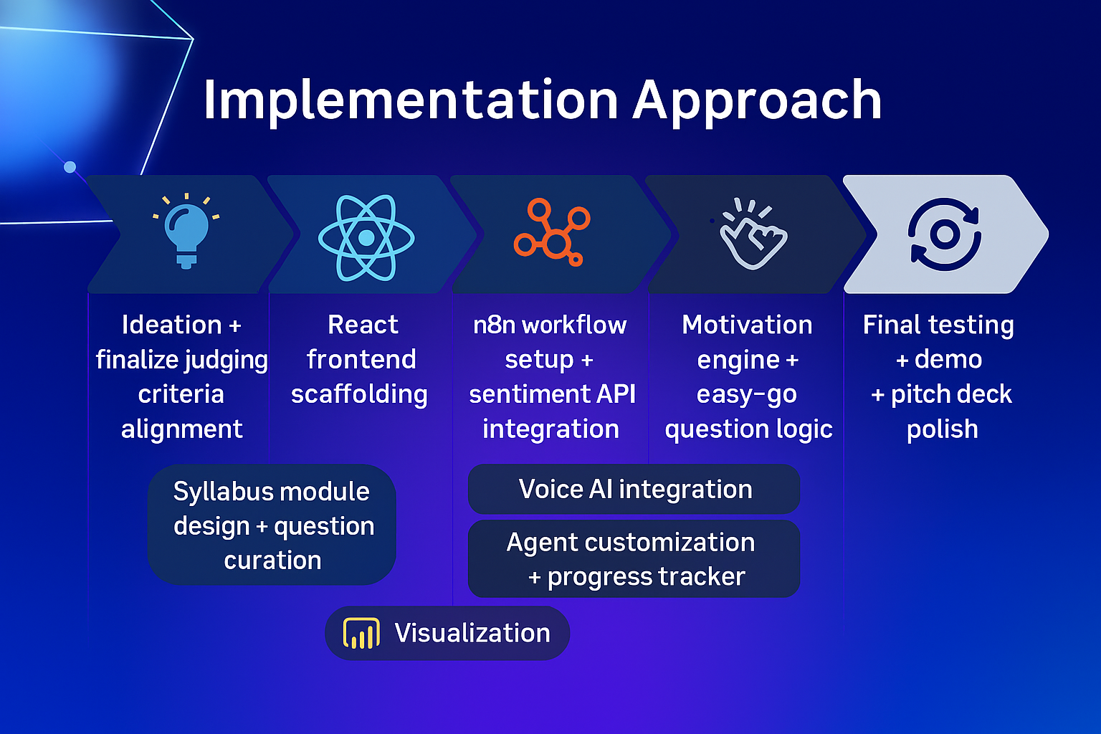
Implementation Approach

Slide 13
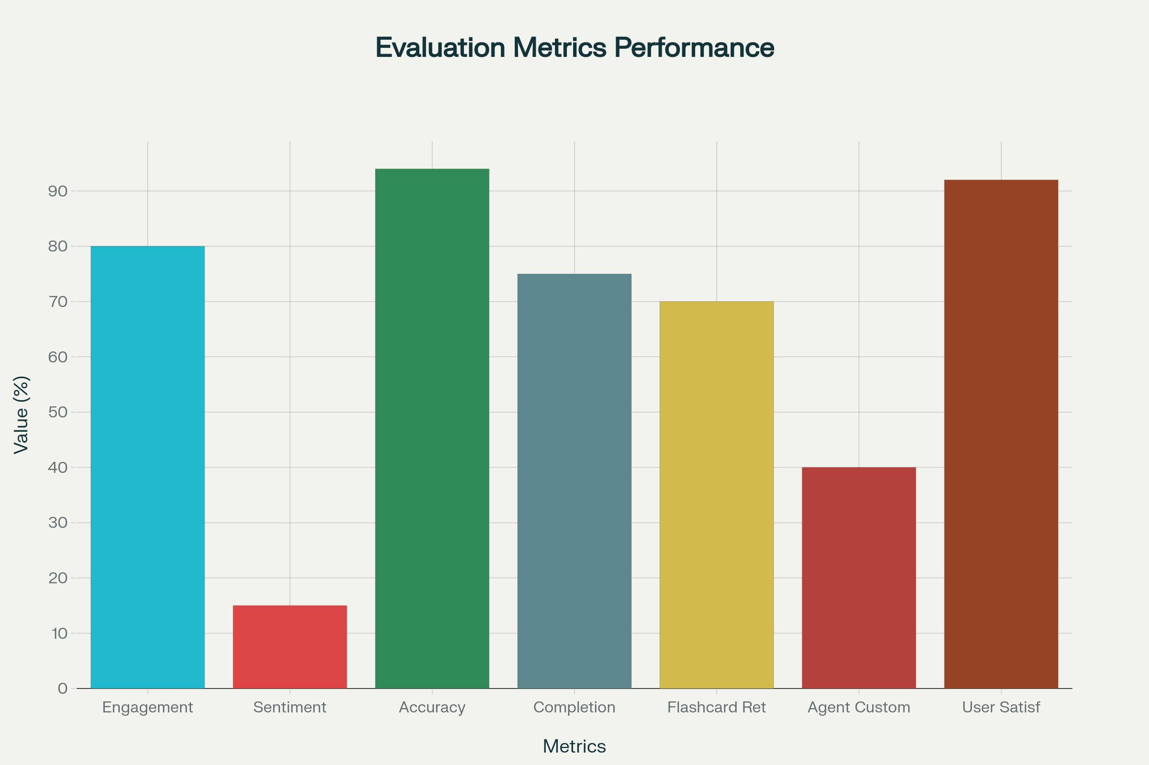
📊 Evaluation Metrics
Student engagement rate
Sentiment improvement over time
Accuracy of emotional classification
Completion rate of modules
Flashcard usage and retention
Agent customization adoption
User satisfaction (via feedback forms)

Slide 14
Unique Selling Proposition (USP)
Agent personalization: Students choose name, tone, and personality
Voice-first UX: Hands-free, accessible study support
Modular automation: Built with n8n for scalable, low-code orchestration
Growth-focused: Tracks emotional resilience and academic progress

Slide 15

THANK YOU!

